Slide 1
Sets

Slide 2
Introduction to Set Theory
A set is a new type of structure, representing an unordered collection (group, plurality) of zero or more distinct (different) objects.
Set theory deals with operations between, relations among, and statements about sets.
Sets are ubiquitous in computer software systems.
All of mathematics can be defined in terms of some form of set theory (using predicate logic).

Slide 3
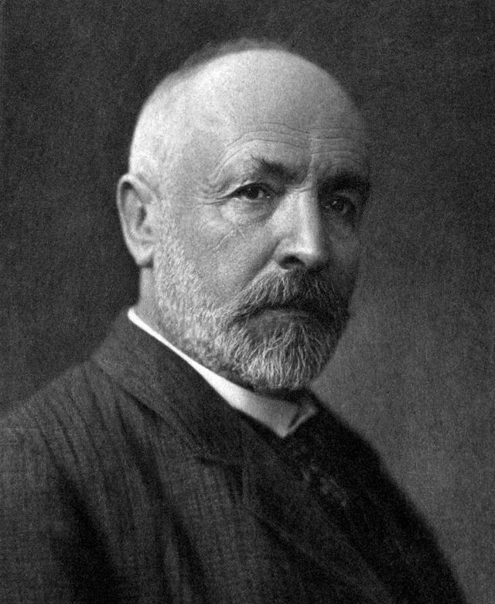
Sets（集合）
A set is a collection or group of objects（对象） or elements（元素） or members（成员）. (Cantor 1895)
A set is said to contain（包含） its elements.
There must be an underlying universal set（全集） U, either specifically stated or understood.
Cantor 1845-1918

Slide 4
Notation
list the elements between braces:
S = {a, b, c, d}={b, c, a, d, d}
(Note: listing an object more than once does not change the set. Ordering means nothing.)

Slide 5
Notation
specification by predicates（谓词）:
S= {x| P(x)},
P(x) denote a sentence or statement P concerning the variable object x.
S contains all the elements from U which make the predicate P true.

Slide 6
Notation
brace notation with ellipses:
S = { . . . , -3, -2, -1},
the negative integers.

Slide 7
Notation
x is a member of S or x is an element of S:
x ∈ S.
x is not an element of S:
x ∉ S.

Slide 8
Examples
{x |x is a positive integer less than 4} ={1,2,3}
{x |x is a letter in the word “byte”} ={b, y, t, e}
If A={BASIC,PASCAL,ADA} and B={ADA,PASCAL,BASIC}, then A=B.

Slide 9
Common Universal Sets
𝕽 = Reals
ℕ = Nature numbers = {0, 1, 2, 3…..}, the counting numbers
ℤ = All numbers = {…, -3, -2, -1, 0, 1, 2, 3…}
ℤ⁺ = The set of positive numbers
ℚ = The Rational numbers

Slide 10
Two sets A and B are equal（相等） if and only if they have the same elements, we write A=B

Slide 11
Empty set（空集）
Definition: The void set, the null set, the empty set, denoted {} or ∅, is the set with no members.
Example:
{x |x is a real number and x²=-1}= ∅.

Slide 12
Subsets（子集）
Definition: The set A is a subset of the set B, or A contained in（包含于） B ,denoted A⊆ B, iff（当且仅当）
∀x[x ∈A→x ∈B]
If A is not a subset of B ,denote A B.

Slide 13
Subsets（子集）
Examples:
ℤ⁺ ⊆ ℤ
ℤ⁺ ⊆ 𝕽
Let A={1, 2, 3, 4, 5, 6}, B={2, 4, 5}, C={1, 2, 3, 4, 5}
Then
B ⊆ A, B ⊆ C, C ⊆ A
Α Β, Α C, C Β

Slide 14
Note
The assertion x ∈∅ is always false. Hence ∀x[x ∈∅→ x ∈B] is always true(vacuously). Therefore, ∅ is a subset of every set, ∅ ⊆ B.
A set B is always a subset of itself, B ⊆ B.

Slide 15
Definition
Definition: If A ⊆ B but A ≠ B the we say A is a proper subset（真子集） of B, denoted A ⊂ B (in some texts).

Slide 16
Venn diagrams（文氏图）
Diagrams used to show relationships between sets after the British logician John Venn
Example:
B
B
A
A
A ⊆B
A B

Slide 17
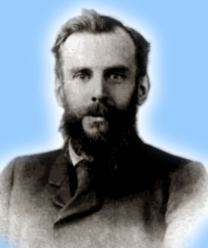
Venn Diagrams
John Venn 1834-1923
0
2
4
6
1
8
Even integers from 2 to 9
-1
3
5
7
9
Odd integers from 1 to 9
Positive integers less than 10
Primes <10
Integers from -1 to 9
Notes:
With Venn diagrams, you can see that one set is a subset of another just by seeing that you can draw an enclosure around its members that fits completely inside an enclosure drawn around the larger set’s members.

Slide 18
The power set
Definition: The set of all subset of a set A, denoted P(A), is called the power set（幂集） of A.
Example
If A = {a, b} then P(A) = {∅, {a}, {b}, {a,b}}

Slide 19
Cardinality（基数）
Definition: The number of distinct elements in A, denoted |A|, is called the cardinality of A.
If the cardinality is a natural number (in N), then the set is called finite, else infinite.

Slide 20
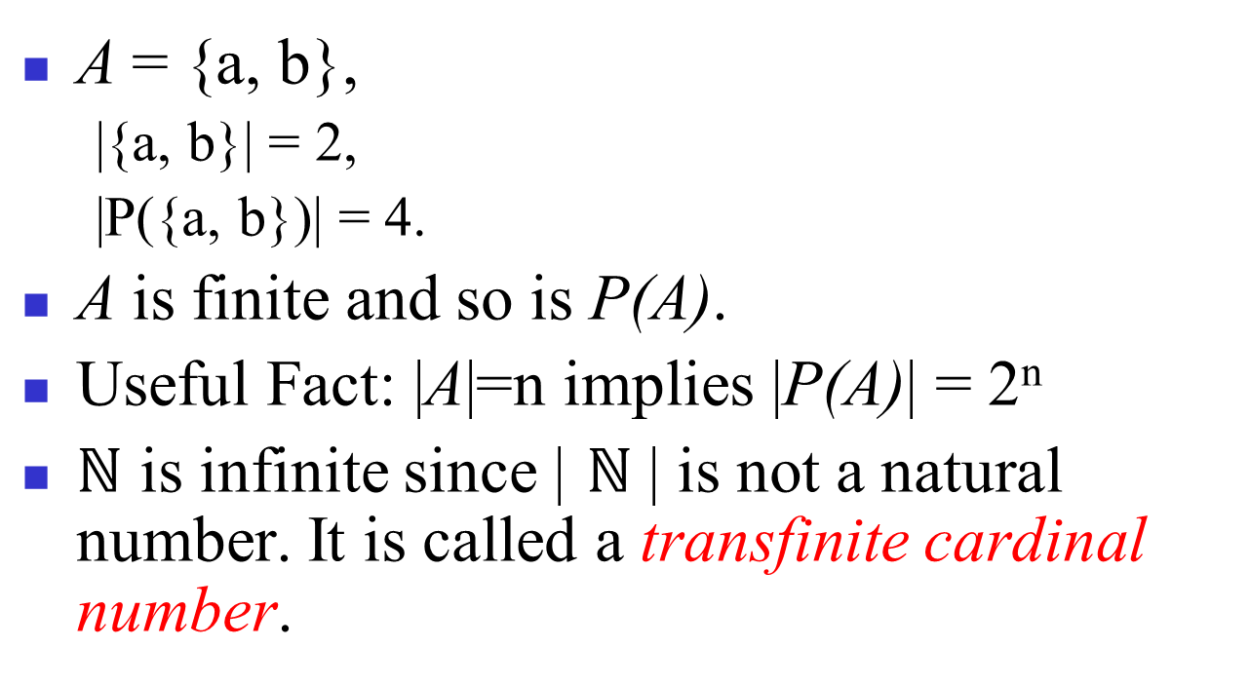
Cardinality - Example

Slide 21
Note
Sets can be both members and subsets of other sets.
Example:
A = {∅,{∅}}.
A has two elements and hence four subsets:
∅, {∅}, {{∅}}, {∅,{∅}}
Note that ∅ is both a member of A and a subset of A!

Slide 22
Example
Let A be a set and let B={A,{A}},Then
A∈B and {A} ∈B
{A}⊆B and {{A}} ⊆B.
A B

Slide 23

单选题
1分
Let S is set. S= {∅,1,{∅, {∅}}}. What is the cardinality of S ?
A
1
B
2
C
3
D
4
提交

Slide 24
多选题
1分
Whichs are the sets that contains {2} as an element?
A
{x ∈ R| x is an integer greater than 0}
B
{x ∈ R| x is the square of an integer}
C
{2,{2}}
D
{{2},{{2}}}
E
{{2},{2,{2}}}
F
{{{2}}}
提交

Slide 25
Ordered n-tuples
Definition:
These are like sets, except that duplications matter, and the order makes a difference.
For n∈ℕ, an ordered n-tuple or a sequence or list of length n is written (a₁, a₂, …, a_{n}), and it’s first element is a₁, etc.
Empty sequence, singlet, pairs, triples, quadruples, quintuples, …, n-tuples
Examples:
(1, 2) ≠ (2, 1) ≠ (2, 1, 1)
{1, 2}= {2, 1}={2, 1, 1}
Contrast with sets’ {}
Notes:
Sometimes people also define “bags”, which are unordered collections in which duplicates matter. If you have a bag of coins, they are in no particular order, but it matters how many coins of each type you have.

Slide 26

Cartesian product（笛卡尔乘积）
Definition: The Cartesian product of A with B, denoted A×B, is the set of ordered pairs {<a, b> | a ∈A ∧ b∈B}
Notation:
Note: The Cartesian product of anything with ∅ is ∅. (why?)

Slide 27
Example
A = {a,b}, B = {1, 2, 3}
A × B = {<a, 1>, <a, 2>, <a, 3>, <b, 1>, <b, 2>, <b, 3>}
What is B × A? A × B × A?
If |A| = m and |B| = n, what is |A × B|?

Slide 28
Using set notation with quantifiers
Example 22
What do the statements ∀x∈R (x² ≥ 0) and ∃x∈Z(x²=1) mean?
For every real number x, x² ≥ 0. This statement can be expressed as “The square of every real number is nonnegative.”
There exists an integer x such that x² = 1. This statement can be expressed as “There is an integer whose square is 1.” This is also a true statement because x = 1 is such an integer (as is −1).
A={x∈ R | x² ≥ 0}
A={x∈ Z | x² = 1}

Slide 29
Truth Sets of Quantifiers
Definition：
Given a predicate P, and a domain D, The truth set of P(x) is denoted by {x∈D | P(x)}.
Example 23：
What are the truth sets of the predicates P(x), Q(x), and R(x), where the domain is the set of integers?
P(x) : |x| = 1
Q(x) : x² = 2
R(x) : |x| = x

Slide 30
Review of 2.1 Set
Definition of Sets
Special sets: 𝓡,ℕ,ℤ,ℚ
Set notations: {a, b,…}, {x|P(x)}…
Relations: x∈S, S⊆T, S⊂T, S=T…
Cardinality
Power set
Cartesian Product

Slide 31
homework
2.1
8,12,18,24,48

